Slide 1

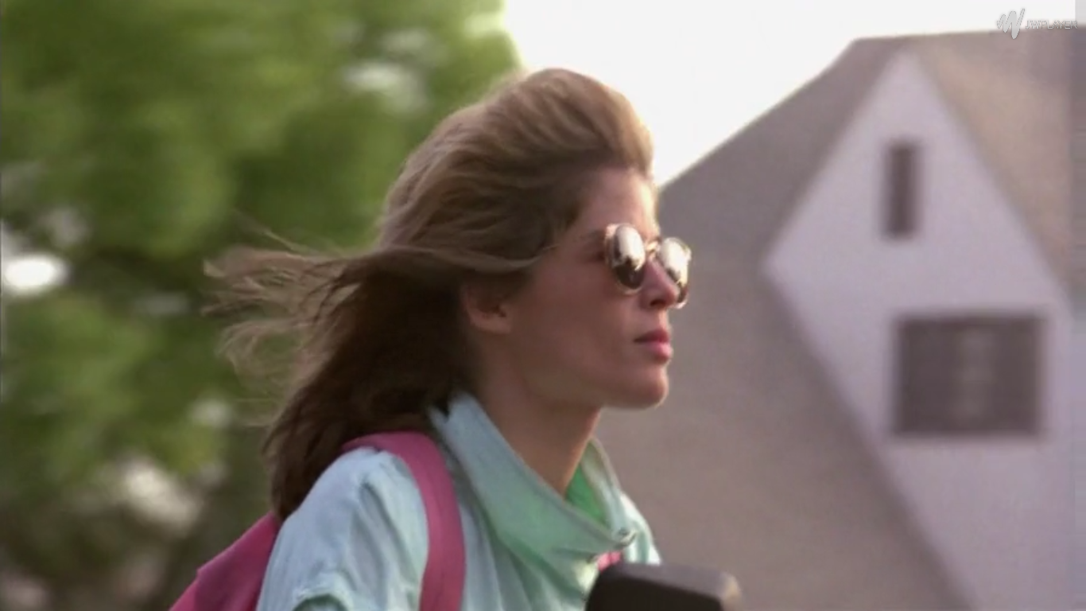
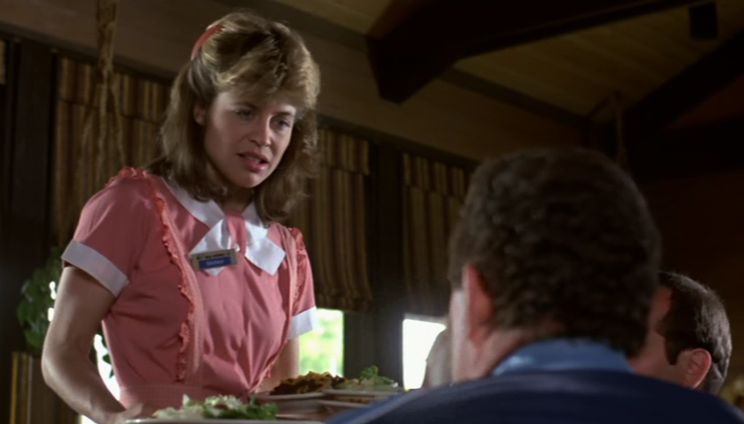
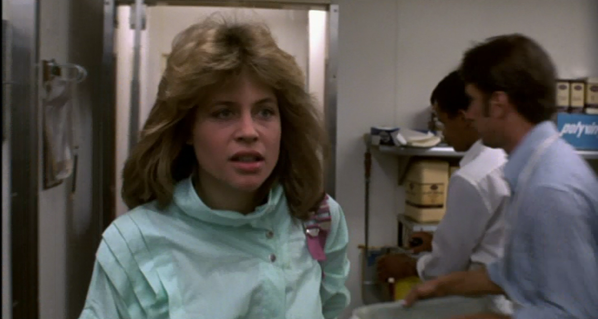
Mise-en-Scene:
The Terminator scene analysis
Introduction to Sarah Connor
By Liam & Zoey

Slide 2
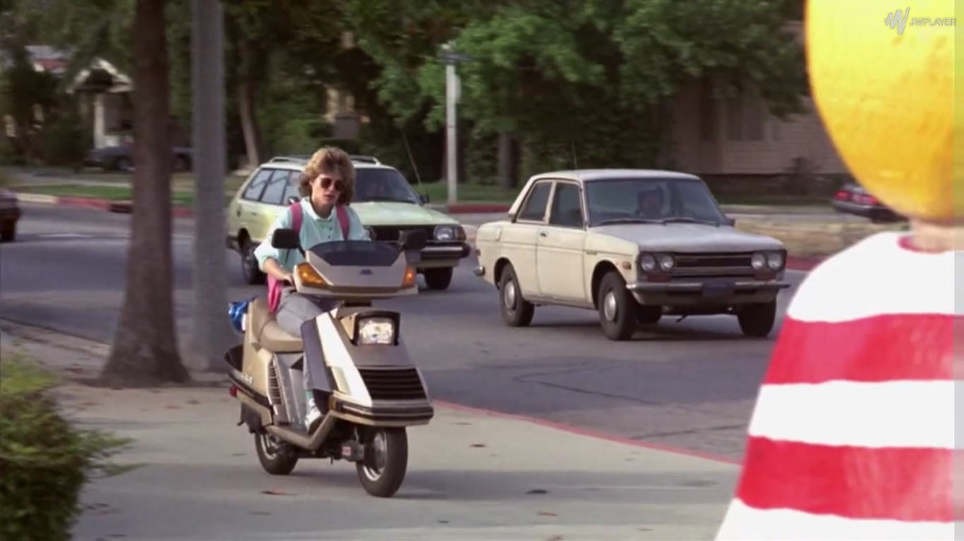
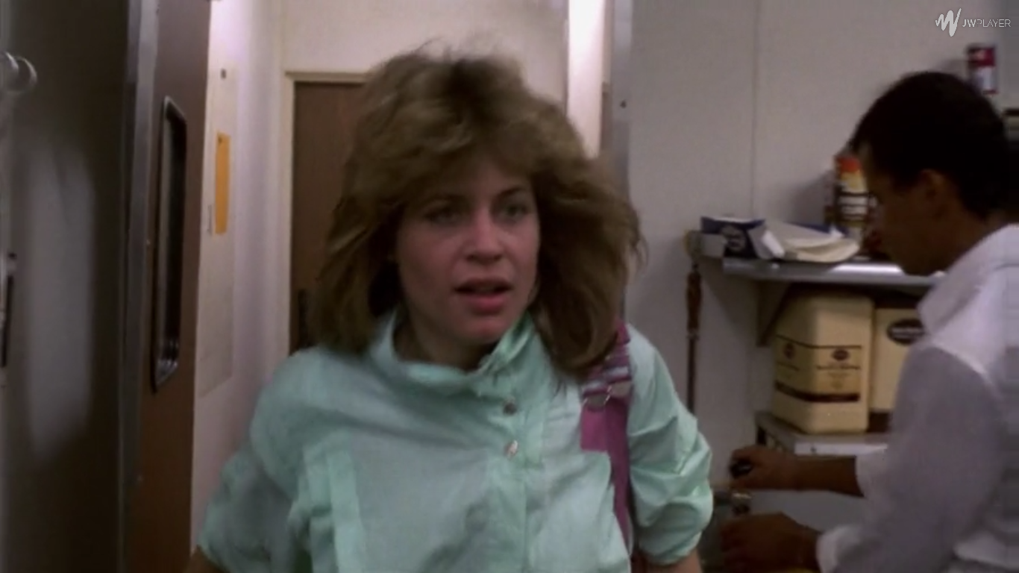
Setting and Props
Introduction to Sarah Connor
  Focus on her – The scene switches from the dark and damp alley ways of downtown Los Angeles to the bright, busy and colourful setting of the suburbs. Sarah Connor rides into the shot on her bike as she travels to work. The scene uses light, positive and cheerful music in order to convey her carefree lifestyle.
  However, when she enters the bar, the atmosphere suddenly changes and the music silences as her colleague suddenly tells her she is late and tells her about all the work she needs to do etc.
  As she’s serving people, she comes across as a typically people pleaser in her work environment trying to make everyone happy and do her job correctly, this also represents how little power she has and is reliable on everyone else.

Slide 3
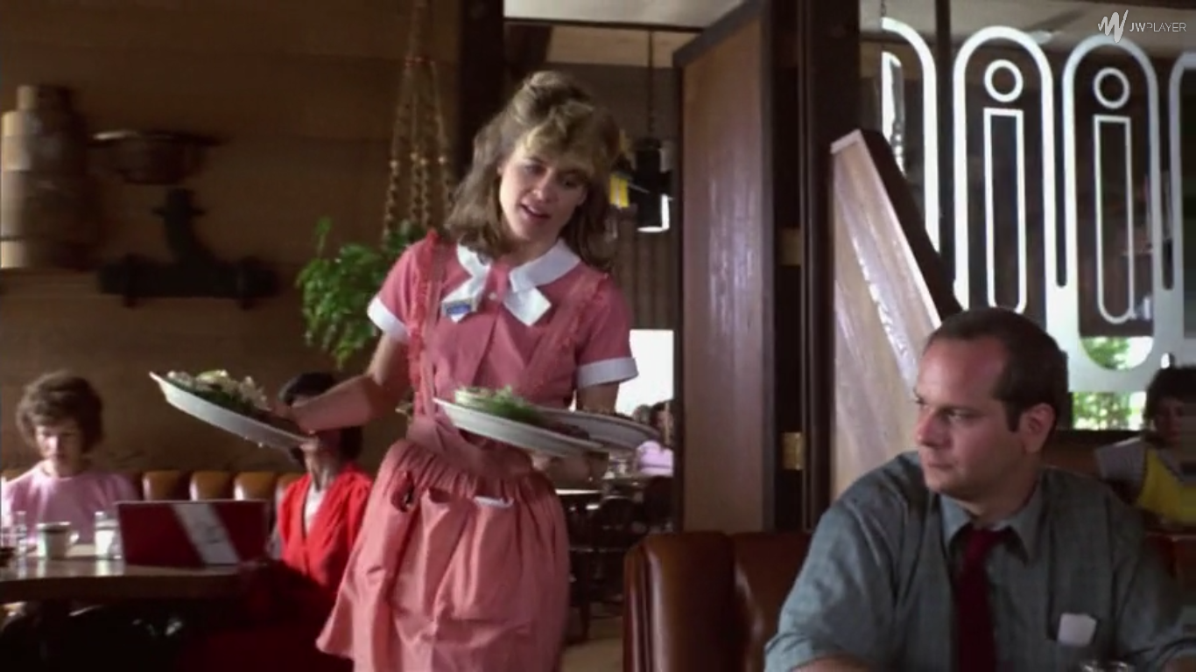
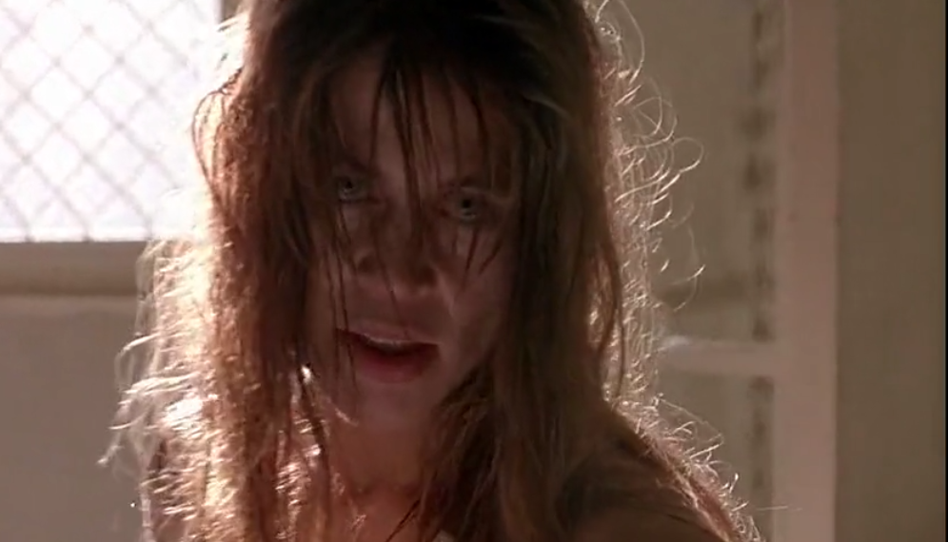
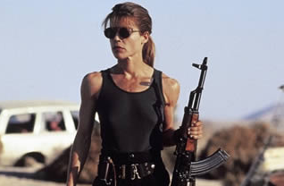
Costume, hair and Makeup
The Terminator:
  When we see Sarah Connor riding on her bike, her hair is floating in the wind - this represents the idea that she has a lot of freedom and has no responsibilities.
  She wears her work uniform which is a bright, colourful and frilly - These elements glamourize Sarah Connor and her lifestyle in order to suggest that she is a typical innocent female with little responsibilities and roles in life.
  In contrast, the appearance of Sarah Connor within terminator 2 juristically changes from the first film. For example, Sarah Connor loses her stereotypical innocent portrayal representing her powerlessness from terminator 1 and becomes both a mentally and physically stronger character in the second film: such as the way in which she turns her cell into a training room and we are later shown that she’s learned how to use different weapons – this represents how she has become more aware of her situation and how she needs to undertake her role in order to destroy the terminators and how she has become less reliant on others to save her, this contrasts with stereotypical attitudes and roles towards women in society at the time.
Terminator 2:

Slide 4
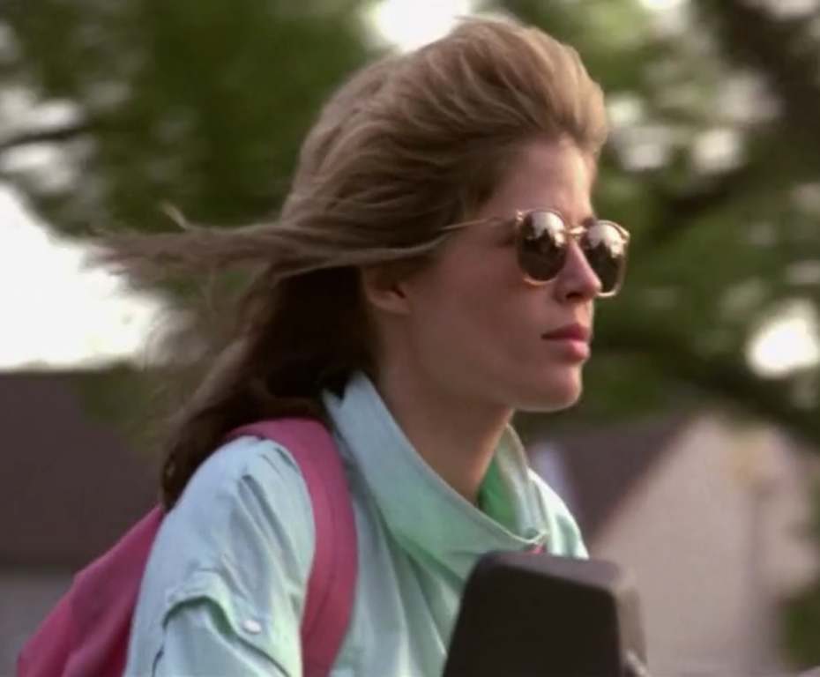
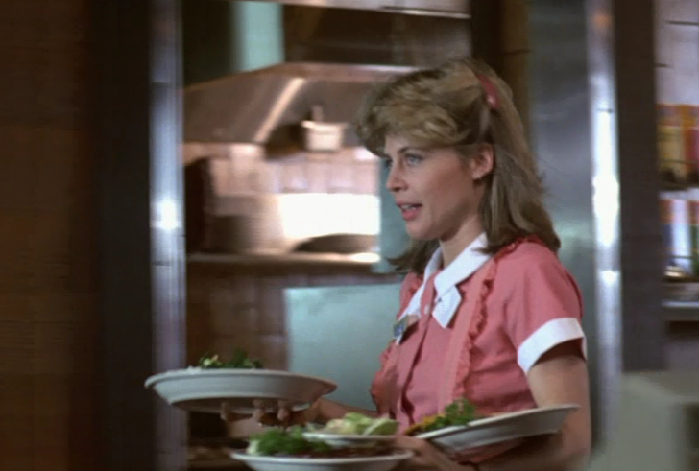
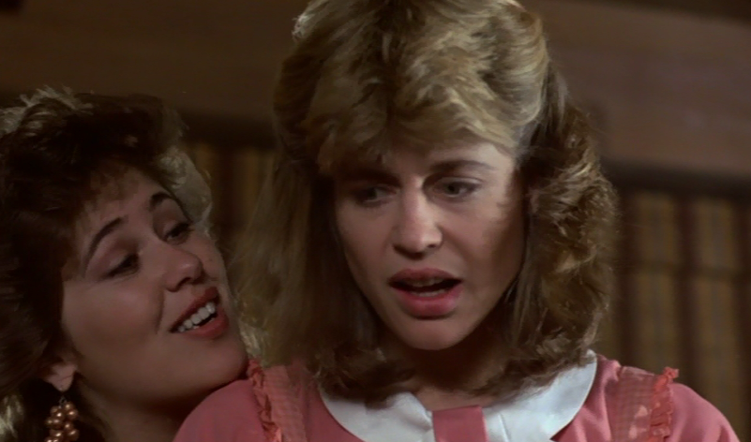
Facial Expressions and body language
  When we see Sarah Connor riding on her bike she seems happy and content however when she is in work, her appearance and facial expressions become more stressed and appears to be more vulnerable as the men at the table receive the wrong order and complain.
  The first time we see Sarah Connor she appears to be happy and carefree, although we don’t know much about her character at the time – it can suggest the carefree and happy lifestyle that she lives.
  As she arrives to work her facial expressions become more stressed and serious eg. she has a stressed facial expression as she carries out the plates to the customers.
  She comes across as shy and vulnerable when she is talking to the men and other people – this can suggests a lack of self confidence she has for herself.
  Shocked facial expressions as the young boy puts food down her dress. Represents how the little power she has as even small children are able to belittle her, furthermore none of the men around her help – this represents the strong patriarchal society at the time.

Slide 5

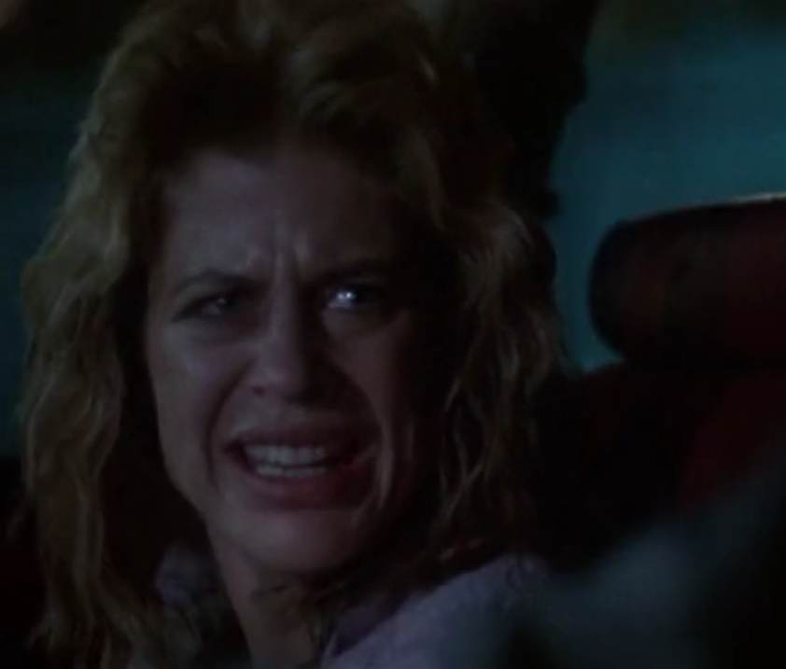
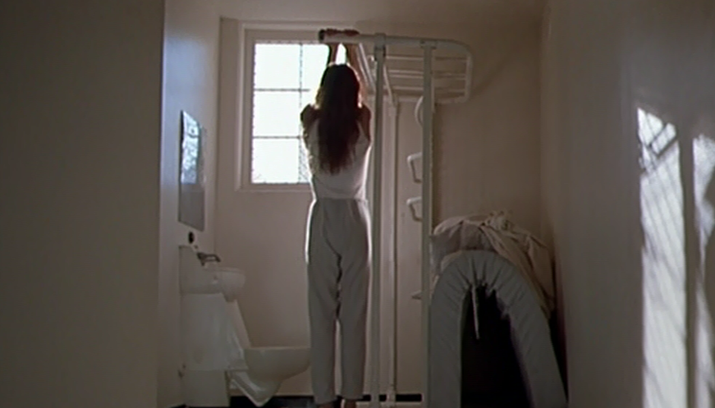
Other Scenes:
  In the final scene of The Terminator, we see Sarah Connor making audio logs for her unborn son. Her facial expressions in this final scene shows how she has taken responsibility and has become a stronger person. For example when she says that she knows a storm is coming – This metaphor for the return of the terminators and her role to prevent the events of the future.
  Later on in the film, we see Sarah Connor and Kyle Reese trying to escape from the terminator. During the Scene, We can see that Sarah Connor Still refuses to take any responsibility in her situation and she questions Reese about the terminator through her facial expressions, body language and speech.
  Similarly to earlier, terminator 2 contrasts in that the body language of Sarah Connor is dramatically different to the first scene of Sarah Connor In the first terminator. One of the first scenes we see of Sarah Connor in terminator 2 is one where she is stuck in a cell of a mental institute – while she is in isolation in her cell, she still maintains to take control of her situation by using her bed as equipment in order to train.
  She uses sarcasm when talking to the guards in order to give her power, for example when she is talking to Dr. Peter Silberman she says “How’s your Knee” – this shows how even though she is being contained she is still rebelling and fighting back – Furthermore it suggests that she has not given up hope in what she is fighting for.
  Factors such as this presented the idea that Sarah Connor has become a stronger character, this in turn presents her with more power and has a sense of authority among different characters in the narrative.

Slide 6
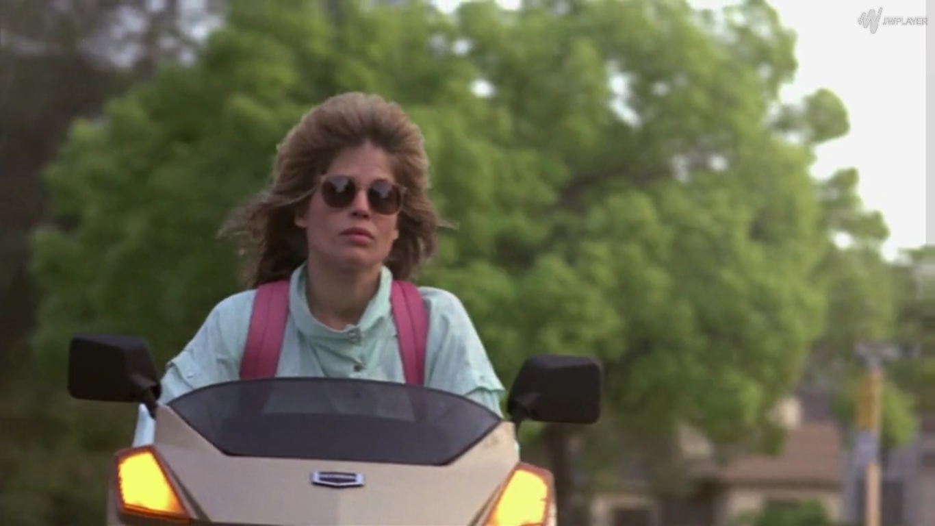
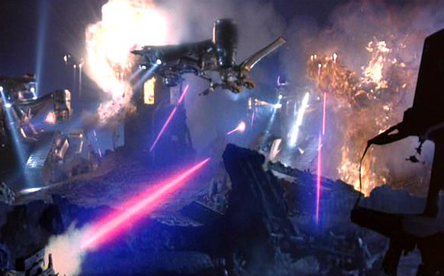
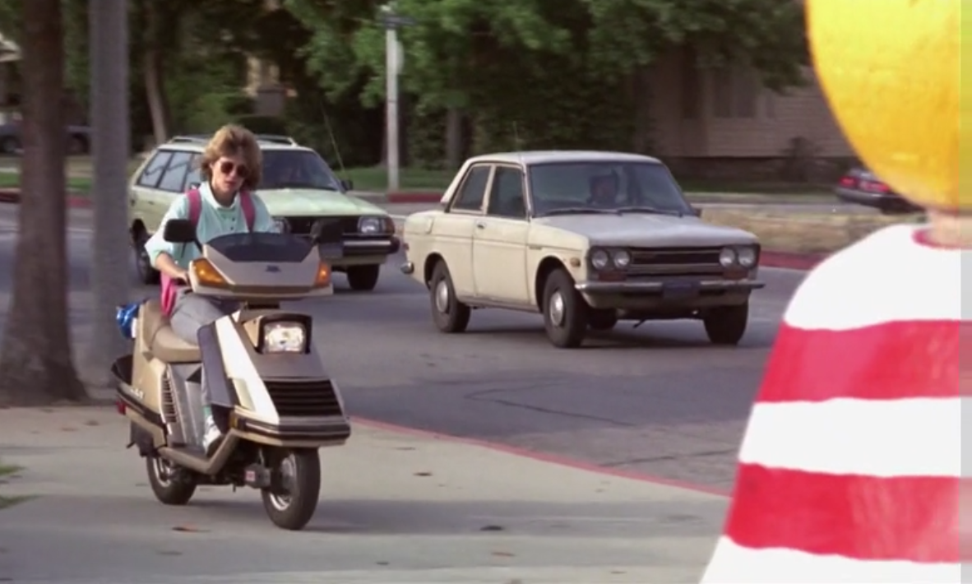
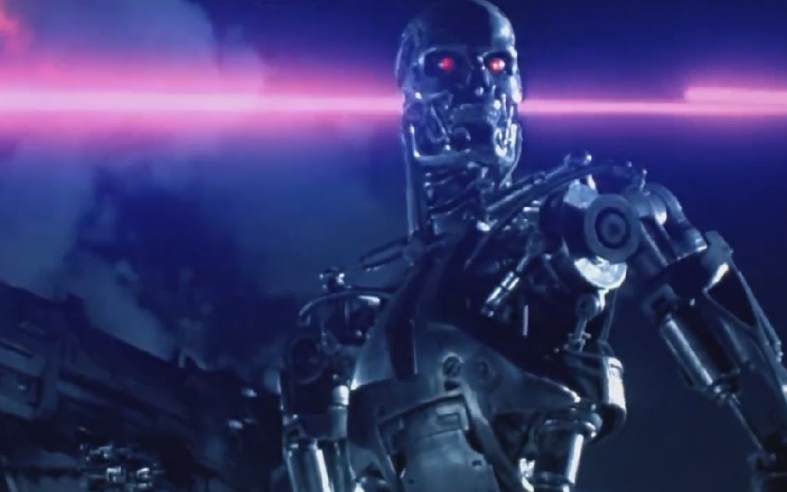
Lighting and colour
  Lighting and colour is a fundamental aspect in film and the mise-en-scene of a film, it is therefore largely responsible for how a film looks. Colour and lighting can be used in order to: create different atmospheres and tones of the scene, create a feeling or emotion and can be used artistically for effect. The Terminator uses a number of different colours and lighting stylistically in order to convey different tones in each scene:
Intro to Sarah Connor:
Future LA Setting:
  The lighting and colour of the scenes in the future are drastically different to the bright and vibrant colours used when we first meet Sarah Connor. James Cameron uses dark and ominous colours with minimal lighting in order to achieve the post apocalyptic war setting. The dark colours compared to the bright and colourful setting of the past suggests how the future is a dystopian setting which is ultimately ‘doomed’.
  When we first meet Sarah Connor, the colours and lighting is bright and clear. The use of these bright colours creates a positive and bright tone – this mirrors the representation of Sarah Connors carefree lifestyle. The use of little dark colours contrasts to the scenes we see of the dystopian LA future.

Slide 7
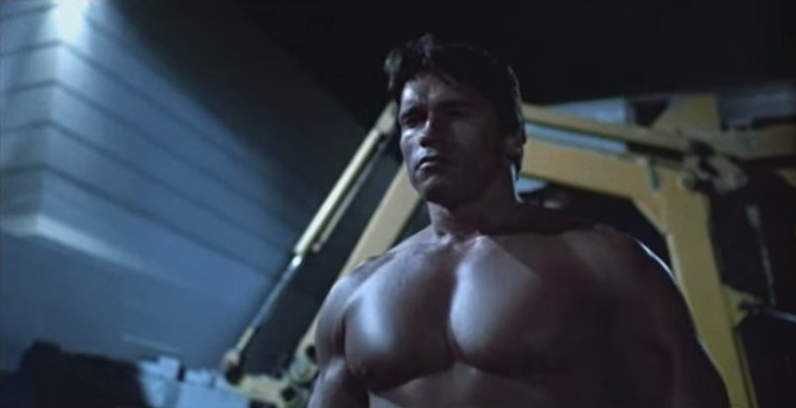
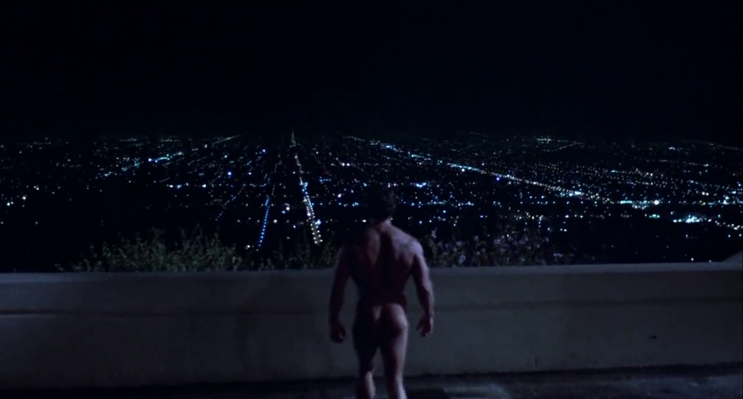
Positioning of characters and objects in the frame
  The choice of camera angles and positioning of objects in the frame can largely effect the tone and our perceptions of a character. The Terminator positions characters differently in scenes in order to effect the audience:
  When we first meet Sarah Connor, she is positioned in at medium length and angle. This choice of positioning is fairly basic and neutral.
  In contrast, Cameron uses low angle and crane shots in order to present the idea that it has authority and power over others. These shots belittle the viewer in order to suggest how the terminators are more advanced and ‘better’ than humans themselves.

Slide 8
Slides By:
Setting and Props - Zoe
Costume, hair and Makeup – Zoe
Facial Expressions and body language – Liam
Other Scenes – Liam
Lighting and Colour – Liam
Positioning of characters and objects in the frame – Zoe

