Slide 1
The Sci-Fi Genre
Me and My Movies

Slide 2
Why Science Fiction?
Science fiction is the exploration of future technologies, sciences and societies or the exploration of space or alien races. The science fiction genre has the ability to cover a wide range of scope and different sub-genres, from sci-fi thrillers like Ridley Scott’s Alien to sci-fi comedies like Paul, Men in Black, Guardians of the Galaxy or Ghostbusters. Since I was young, I was always interested in the action and adventure genre, however the science fiction genre has gradually become more of interest to me. One of the main reasons why science fiction is my favorite genre is because of its many deep and meaningful messages about humanity, life and ways of life: Such as the important and prevalent messages of mother nature and the links of globalization of our own planet depicted through exploring space within James Cameron’s Avatar. Or the message of what it means to be human and human relationships explored through Ridley Scott’s, ’The Martian’. These important messages explore a variety of both political and personal issues which are very important in our modern day lives. Furthermore, science fiction is often used a way of raising these important messages and debates in society and reflects us in a different light in each film. Another aspect of science fiction which I find interesting is its relationships with potential technologies and its affects on the technologies we use in our every day life. For example the inspiration of smart phones and mobile technologies featured in the likes of Star Trek etc. Science fiction creatively projects ideas of future technologies and possibilities in our society, such as the interestingly odd relationship between humans and computers. Overall, I feel science fiction is one of the best genres in film as it offers an insight into different worlds and characters which encourages strong responses in ourselves.

Slide 3
Active Spectatorship
What is it?
Active spectatorship explores the relationship between audiences and film, this relationship is explored through a variety of different theories about how people as an audience interact and how media influences different audiences. There are essentially two main aspects of this topic, active and passive viewing. Active spectatorship is the theory or belief that viewers are emotionally invested in a film and will each has a different and developed emotional response and have the ability to develop their own ideas about the films messages and ideas. Passive spectatorship is the theory is the opposite, whereby the audience of a film takes in its ideas and messages but doesn’t encourage audiences to create or develop their own ideas after viewing a film. The theory suggests that people have the same intelligence and will ‘unconsciously absorb’ the ideas of the film; however, this is not always a negative thing in film.
Spectatorship Theories: The Hypodermic Needle Model
One of the main theories involved in the topic of active spectatorship is ’The Hypodermic Needle Model’. This model takes on the passive spectatorship theory on board, it suggests that media is ‘linearly’ injected or taken in by audiences in the same way. For example a film promoting particular ideas or messages and ’injecting’ them into an audiences brain without any thought from the audience.

Slide 4

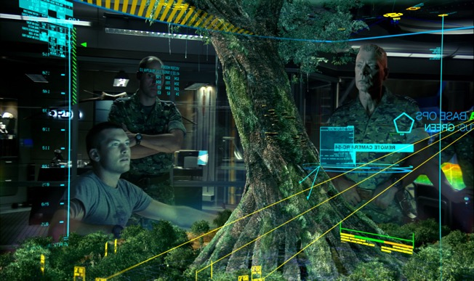
Active Spectatorship Continued
Spectatorship styles in Science Fiction film:
Often in film, a director will aim to either provoke or encourage active or passive spectatorship. This factor often depends on what type of film it is and what the directors message is within the film itself. In science fiction film, active spectatorship may be encouraged in order to provoke a strong message or to elicit an argument, opinion or emotional response over the story, characters or decisions of a film. As said earlier, one of the strongest messages I feel that have been told by encouraging spectatorship types in science fiction film is through James Cameron’s cinematic masterpiece, Avatar. The film had the important message that we need to preserve our connection to nature and respect other cultures, animals and environments. While Avatar can be viewed as an encouragement for passive spectatorship in the way that it attempts to pass on Cameron’s message about nature, I personally feel it encourages an active spectatorship style, for example: I feel by the end of avatar, audiences are compelled to make their own decisions on what we are doing a little closer to home on Earth rather than in space, for example messages about what we are doing to the environment and indigenous communities.

Slide 5
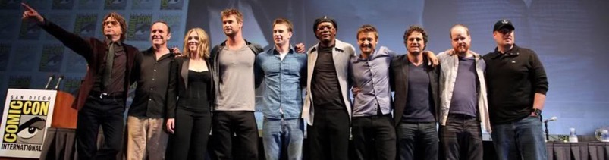
Fandom
The Science Fiction Genre has one of the largest ‘Fandom followings’ in the industry. Fandom is loosely defined as “The community that surrounds a tv show/movie/book etc. Fanfiction writers, artists, poets, and cosplayers are all members of that fandom. Fandoms often consist of message boards, livejournal communities, and people.” The most significant reason or encouragement for fandom within modern society is the internet. Often after watching films, people tend to go on the internet to do further research about the topic, story characters or narrative of a film. It is here on the internet, where through social networking and online communications, people will often share their fandom for something through these networking sites and communicate with each other through blogs etc. Over the years, fandom has rapidly increased and become more and more popular throughout different communities, most likely due to the developments in technology. Fandom has increased and developed so substantially that there are events all across the world such as ’Comic-Con’. An event whereby hundreds of thousands of fans will come together and share their fandom for all types of media, from film, gaming, comic books etc. At these events This has not only become a popular event for the fans of different franchises, but also the producers of films. A prime example of this is Marvel Studios, Marvel have been making science fiction comics and films for decades, and nearly every year they hold a panel:
These panels are often used as marketing strategies to announce and promote their upcoming films, this can involve not only the producers of the film attending in front of the audience, but also the all star casts they may have as well. Over the years, this has effectively been used as a promotional method for Marvel to gain buzz and excitement
for their upcoming films effectively.

Slide 6
Reading Types
There are essentially three different ‘reading types’ when looking at the responses towards film. One of which is oppositional reading, this is where the response to a product is directly the opposite to the response that producers would hope for and are in complete disagreement with the message or meaning of the film. Negotiated reading is where the audience are partially in agreement or disagreement with the messages explored in a film. The third is Preferred Reading, this is where an audience will respond positively in the way the directors intended and agree with its messages. Most film makers will aim for a preferred reading response, where the ideas of a film will be taken on-board and will be received positively. In turn, this type of response will get people talking about the issues or themes represented within the film, through the example of Avatar again, I feel the responses from critics once watching the film were largely preferred, whereby the messages shown through the sci-fi film were largely received positively and taken on board by the audiences and brought important issues to the table. Personally, after watching Avatar, I feel that the messages contained by the story I largely agreed with and was invested in the story that Cameron wanted tell.
The responses of these reading types are very useful towards a director, ultimately It helps a director to see if the message being made about their film is being taken in and positively received. In terms of Avatar, the message was very strongly received and got preferred readings overall, as a result Cameron is set to make additional upcoming sequels over the years with these similar ideas throughout.

Slide 7
Frameworks of Interpretation
Frameworks for interpretation relates to the ways in which audiences interpret or perceive elements such as characters, settings, or narrative in their own or individual ways. A persons individual interpretations will depend on a variety of factors such as their social background or education for example. Science fiction is one of the most open to alternate interpretations in the film industry. With a vast range of storylines and possibilities within their narratives, the scope for audiences to create ‘fan theories’ or their own interpretations. Many of these interpretations vary largely depending on the film, here is a video of a range of different fan theories that change how the film is for an audience.
https://www.youtube.com/watch?v=zpwRA
9KQnWU
Personally, I tend not to develop my own theories or speculate about the different interpretations of films, as a result I will usually leave a film open to a range of ideas rather than creating my own definitive ideas. Furthermore, many most of my ideas are based from what I feel the directors and producers are telling from the story. Again with the example of avatar, the message which is clearly being made is about the protection of nature and different cultures on our own planet. I would also say that I generally ’sit on the fence’ when it comes to alternative interpretations, as a result, I often turn to social media platforms such as YouTube to look for reviews or to find critics or different audiences opinions on the film to help develop my own ideas or interpretations when it comes to film.

Slide 8
Frameworks of Interpretation Continued
Demographics:
Another fundamental aspect when it comes to the interpretations of film is the background and demographics of each member of an audience. This could be due to a vast range of different factors, such as the genre of the film itself, the age rating of the film etc. For a close example, certain genres are stereotypically linked to a gender, for example: a romance film may be targeted more towards females than males, and a science fiction film may be targeted towards males slightly more than women. Therefore, different interpretations will be made about a film depending on the type of audience. An example of this is in the Terminator films.
In The Terminator films, we explore the character of Sarah Connor: within the first film, she is represented very stereotypically at that time through the fact that she is represented as very vulnerable and reliant upon men as shown in my Talking Heads video. As a teenage boy, I feel this trope and representation is very common in film certainly at the time and perhaps am used to this representation. However, I certainly feel that this should change, its important to note that this is also occurring in the film industry such as in the latest installment of Star Wars, the Ghostbusters Reboot etc. A female however, would most likely have a different view than the industry did at the time of Terminator, for example they may have disagreed with how Sarah Connor was represented through her lack of authority, responsibility etc. shown throughout the film.
Within Terminator 2 however, there were many changed made to the character of Sarah Connor, for example she became a more stronger and more self-reliant etc. For a female viewer, this could have have affected them or made their own interpretation different to another. Within Terminator 2, we also see Sarah Connor in her relationship with her son, this could also effected the way in which a mother could have identified with the character through their need to protect and nurture their children for example. Again, this could mean that men perhaps wouldn't identify with or view her character as well because of her representation in the film.

Slide 9
Intertextuality and media Literacy
Intertextuality is defined as the link between different media texts or types of media. This can be subtle links in cinematography or full references. Many different science fiction films have references to other stories and media, for example through the Star Wars films or Deadpool. Here’s a great video on the idea of intertextuality in film. The video explores this idea in a variety of different films mainly focusing around Science Fiction. The video effectively highlights how intertextuality is often used as ‘fan service’ for audiences who have knowledge and experience of other mediums.
https://www.youtube.com/watch?v=8BUaFqgwm-M
https://www.youtube.com/watch?v=QeAKX_0wZWY
https://www.youtube.com/watch?v=9EPu99h2mno
A great example in particular is through Deadpool and Star Wars. Deadpool is a very ‘meta’ film which depicts the comedic ‘merc with the mouth’ Wade Wilson by constantly breaks the fourth wall between the narrative and its audience to the point of becoming self aware, while doing so: the character constantly references pop-culture and a range of popular texts of media. For Deadpool, this was effectively used for comedic relief within the film, however film often uses intertextuality for a range of other purposes, such as for the narrative purposes or to elicit an emotional response in viewers., such as the Millennium Falcon, Han Solo and Chewbacca example from the video in Star Wars: The Force Awakens. This was due to the many fans of the original trilogy, where the fans had not seen these characters etc. in 30 years, eagerly awaiting their return. Therefore as soon as these beloved characters return, the older fans of the franchises with different contexts and references from the other films will be happy to see and give them a nostalgic feeling.
Personally, when I watch films such as those produced by Marvel, I always tend to look for references which are made to other films, this is very common in superhero franchises in particular. Also known as ‘Easter Eggs’, there are many types of references and links within these films which the Fandom side of audiences tend to look for. With an example of Marvel films, nearly all feature a cameo of Stan Lee, the original creator of Marvel comics, the fan side of me therefore is always looking out for where is small part in the film will pop up, purely for no other reason than fan service.

Slide 10

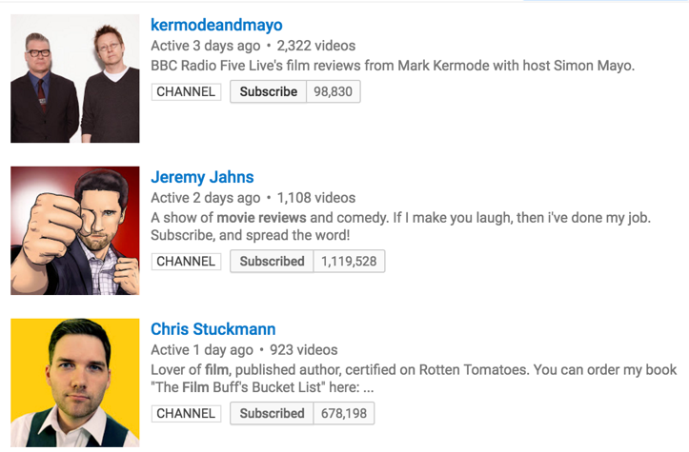
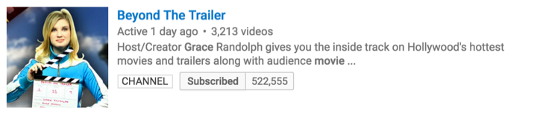
Social Networking
Social Networking is defined as “the the use of dedicated websites and applications to interact with other users, or to find people with similar interests to one's own.“ In a world of continuous progression and developments in technology, more and more of us have taken to the internet to share our experiences and ideas with each other. These sites have become platforms for people to voice their opinions to a wider range of people and gain larger access to others with similar views, or sometimes apposing. Platforms such as YouTube have almost revolutionized the film industry. Within my ‘Bums on Seats’ assignment, I explained how production companies themselves use social networking sites to market their products to extreme audiences with the ability to reach wide ranges of audiences in small time scales.
However as said earlier, these sites have gradually become more and more platforms for fans and audiences to share their experiences of a product. As aid earlier in frameworks of interpretation, it is here on social networks where critics or fans have this ability to share their own ideas or interpretations of a film, such as film reviews, trailer or scene analysis or spoiler reviews. These forms of social networking is a significantly useful way for not only fans to voice their opinions, but also to be used as a marketing strategy for production companies.
I often use social media as a way to find others ideas and opinions in response to watching a film, for example reading or watching film reviews. I often then use these to help formulate my own individual ideas about a film.

Slide 11
Conditions of Reception
This is a film theory developed the 1980’s-1990’s which relates to how audiences respond to a film based on the conditions and how they consume a product, this can involve anything from the environment or platform of consumption to whether the film is a sequel or not. For example, an audience member could receive a different experience when consuming a film in an iMax cinema in 3D compared to using a streaming service to watch the film online on a laptop etc. These cinematic environments are built and designed to provide moviegoers with a unique and captivating experience when going to watch a film.
With the advanced developments to technology and the film industry, the experiences of audiences watching films in a cinema is becoming increasingly improved. For examples, the development of iMax theatres and developments of new 3D technologies allows audiences to become more and more immersed in the films that they watch in cinemas. This experience of audiences with obviously differ when it comes to consuming films over the internet, for example someone trying to watch a film through a streaming service while the video is regularly pausing to buffer will obviously result in a different experience for an audience than if they were to go to an iMax theatre for example. Furthermore, the developments of technologies have also resulted in many illegally watching content through piracy websites, these not only effect the audiences experience when watching a film but is also ruining and discouraging the film industry.

Slide 12
Pre and Post- Viewing experiences reception
Pre-Viewing experiences:
The experiences of fans can vary largely before and after viewing a film product, often in science fiction film, anticipation for a product gradually builds throughout the production stages of the films development. For example during production, a teaser trailer may be released, later on this will lead to full length trailers. Used effectively, these will help production companies to drastically grow the anticipation and acknowledgement of a film while it is being made. A great example of this is with the Star Wars: The Force Awakens trailers, as said in my ’bums on seats’ assignment, the trailers for The Force Awakens were premiered on live TV and through YouTube, on this site it gained 88 million views in 24 hours alone. This created an extreme amount of anticipation for the film after the franchises long awaited return. Additionally, production companies will usually get the stars of the films to do interviews about the film, again this is also a way of getting audiences to anticipate the product more. Personally, as an avid film watcher, I usually tend to watch trailers for upcoming films in order to see what the film may be like or to gain interest in the film. Creative marketing will often set high expectations for a film or product, this will therefore help to gain as much sales as possible.
Post-Viewing experiences:
Post viewing experiences of audiences can often be affected in a wide range of ways, from reading or watching movie reviews before or after seeing the film. For example, if audiences read or watch press film reviews ahead of release or going to watch the film, their own experience or opinions may be substantially affected or altered because of it. Often, these reviews can also discourage audiences entirely to not watch a film at all, for example if someone watched a film review whereby the reviewer disliked the film completely, a viewer may take their word for granted before going to see the film. There are many cases where the audience responses or sales of science fiction films in particular have been affected by the initial audience responses. Personally, I do tend to watch movie reviews prior to watching a film, however I tend not to use these reviews as a basis or determinant for whether I go to watch a film myself. That being said, I often use reviews to develop my own ideas as said earlier in intertextuality and social networking. Using the example of The Force Awakens again however, the high anticipation leading to the films release and its post post viewing responses encouraged me more to see the film and increased my own anticipation for the series’ new revival.

Slide 13
Conclusion
In conclusion, these ideas and contexts in the film industry often effects audiences in a variety of ways, from social networking being used for the marketing of a film to the messages being told within the film itself. Throughout this presentation, I discussed my personal opinions and experiences when it comes to film, such as my own opinions when it comes to actively or passively consuming the messages put forward of film producers. Creating this has also helped me to not only learn more about the film industry itself when it comes to general responses of a film and their effects on the performance of a film itself, such as learning about the different reading types and their effects on a film. This has also helped me to identify perhaps some of the flaws perhaps involved in the industry of sci-fi film, for example the ways in which females are represented in science fiction film or the ways in which audiences identify with different characters and how this will affected female audiences themselves and in return how the responses affect the performance of a film overall.
By Liam Pym

Slide 14
Bibliography
https://www.youtube.com/watch?v=Qt5MjBlvGcY
https://www.youtube.com/watch?v=TBkAbQCYF_w
http://ilovethatfilm.blogspot.co.uk/2013/06/the-relationship-between-audiences-and.html
https://documentaryprojectdp.wordpress.com/2012/01/19/preferrednegotiatedoppositional-readings-stuart-hall/
http://ilovethatfilm.blogspot.co.uk/2013/06/the-relationship-between-audiences-and_16.html
https://www.youtube.com/watch?v=N3vpFGbudpw
https://www.youtube.com/watch?v=9EPu99h2mno
http://ilovethatfilm.blogspot.co.uk/2013/06/pre-and-post-viewing-experiences-and.html
http://www.comic-con.org/
https://ashfilmstudy.wordpress.com/category/conditions-of-reception/

